Slide 2
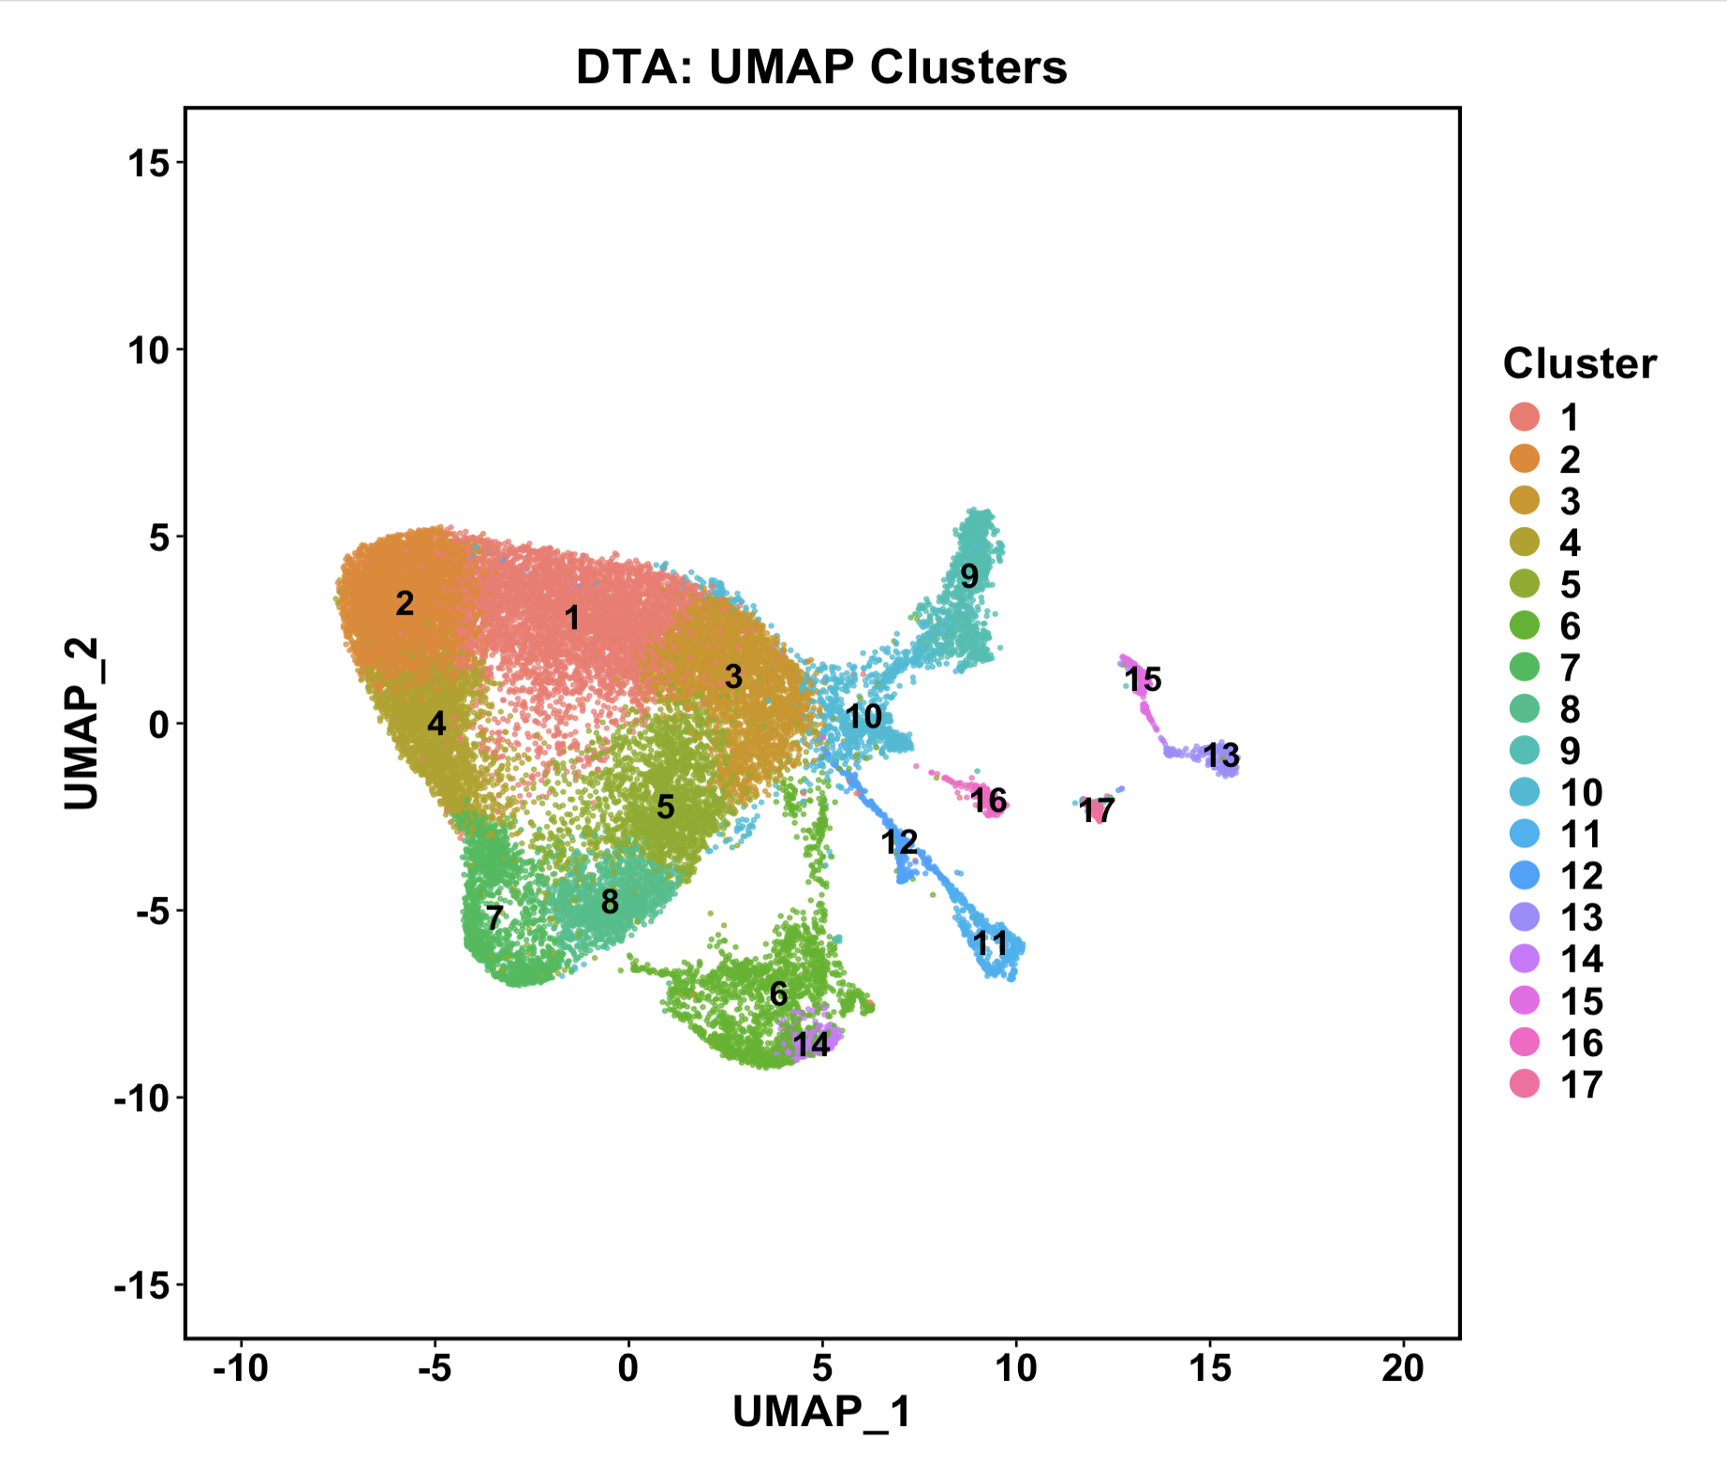
Astrocytes
Endothelial
Granule
Microglia
Fibroblasts
Bergmann glia
Purkinje
Oligodendrocytes
OPC
Interneurons

Slide 3
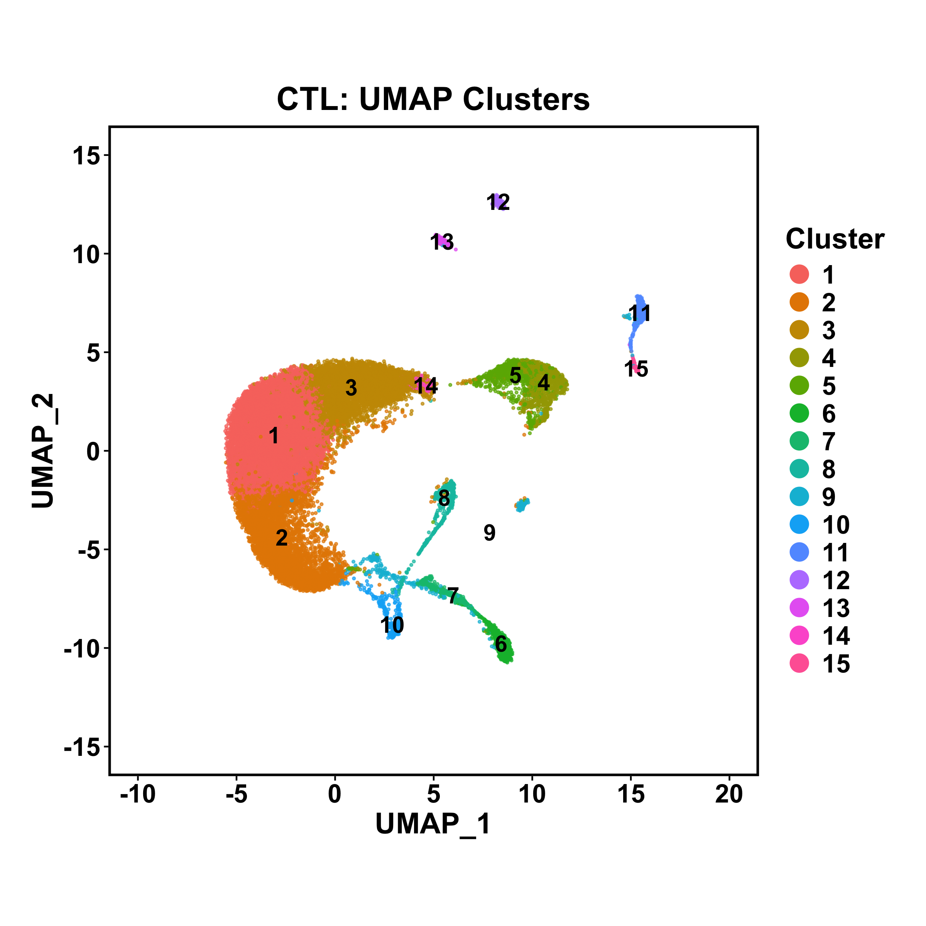
Fibroblasts
Microglia
Endothelial
Bergmann glia
Interneurons
OPC
Granule
Purkinje
Oligodendrocytes
Astrocytes

